Slide 1

Software DEVELOPMENT LIFE CYCLE
Dr. Inderveer Chana | Dr. Ashima Singh | Ms. Harkiran Kaur
Professor and Associate Head CSED, Dean of Student Affairs, TIET, Patiala | Assistant Professor CSED, TIET, Patiala | Assistant Professor CSED, TIET, Patiala
Computer Science and Engineering Department, TIET, Patiala

Slide 2
What is software DEVELOPMENT LIFE CYCLE ?
… Abbreviated as SDLC
Software Development Life Cycle is a set of activities that analysts, designers, and users carry out to develop and implement an information system.
In most business situations, the activities are closely related and even the order of steps in these activities may be difficult to determine.

Slide 3

MAIN TARGETS: SDLC
Quality Software
Meet customer requirements
Completion within time and budget
Image Source: www.pixabay.com

Slide 4
SDLC ACTIVITIES
Preliminary Investigation
Implementation and Evaluation
Determination of System Requirements
SDLC
Framework
System Testing
Design of System
Development of Software

Slide 5
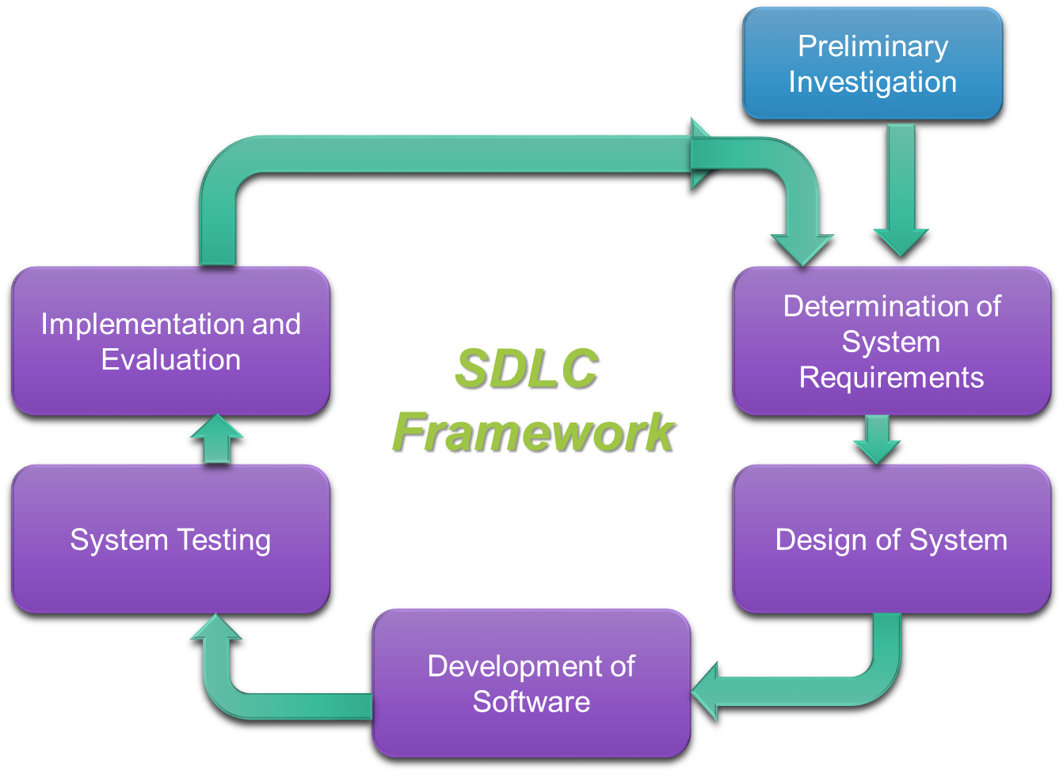
SDLC ACTIVITES
Software Development Life Cycle consists of the following activities:
Preliminary Investigation
Determination of System Requirements
Design of System
Development of Software
System Testing
Implementation and Evaluation

Slide 6
SDLC ACTIVITIES
Preliminary Investigation
Implementation and Evaluation
Determination of System Requirements
SDLC
Framework
System Testing
Design of System
Development of Software

Slide 7
A. PRELIMINARY INVESTIGATION
Three main parts of the activity:
Request Clarification
Feasibility Study
Request Approval
Technical Feasibility
Economic Feasibility
Operational Feasibility

Slide 8
SDLC ACTIVITIES
Preliminary Investigation
Implementation and Evaluation
Determination of System Requirements
SDLC
Framework
System Testing
Design of System
Development of Software

Slide 9
B. DETERMINATION OF SYSTEM REQUIREMENTS
What is being done?
How is it being done?
How frequently does it occur?
How great is the volume of transactions or decisions?
How well is the task being performed?
Does a problem exist?
If a problem exists, how serious is it?
If a problem exists, what is the underlying cause?
Features the system should have, including both the information system should produce and operational features..

Slide 10
SDLC ACTIVITIES
Preliminary Investigation
Implementation and Evaluation
Determination of System Requirements
SDLC
Framework
System Testing
Design of System
Development of Software

Slide 11
C. DESIGN OF SYSTEM
How the system will meet the requirements identified during the System analysis.
System specialists refer to this stage as Logical Design.
Identify reports and other outputs the system will produce.
Describes the data to be input, calculated, and stored.
Provide programmers with complete and clearly outlined software specifications.

Slide 12
SDLC ACTIVITIES
Preliminary Investigation
Implementation and Evaluation
Determination of System Requirements
SDLC
Framework
System Testing
Design of System
Development of Software

Slide 13
D. DEVELOPMENT OF SOFTWARE
Programming the software
Code + Documentation
Preparing documentation of the programs
How and why certain procedures are coded in specific ways

Slide 14
SDLC ACTIVITIES
Preliminary Investigation
Implementation and Evaluation
Determination of System Requirements
SDLC
Framework
System Testing
Design of System
Development of Software

Slide 15
E. SYSTEM TESTING
System used experimentally to ensure that software does not fail and will run according to its specifications and user expectations.
Test data are taken as input for processing and results are examined.
Conducted in parallel with all stages of SDLC.

Slide 16
SDLC ACTIVITIES
Preliminary Investigation
Implementation and Evaluation
Determination of System Requirements
SDLC
Framework
System Testing
Design of System
Development of Software

Slide 17
F. IMPLEMENTATION AND EVALUATION
Implementation
Evaluation
Put new equipment into use
Train users
Install new application
Construct any files of data needed to use it
Operational Evaluation
Organizational Impact
User, Manager Assessment

Slide 18
SDLC ACTIVITIES
Preliminary Investigation
Implementation and Evaluation
Determination of System Requirements
SDLC
Framework
System Testing
Design of System
Development of Software

Slide 19
References:
Senn, J. A. (2013). Analysis and design of information systems. McGraw-Hill, Inc.
Pressman, R. Software Engineering: A Practitioner’s Approach. McGraw-Hill

